Slide 1
Lecture 2 Importing Data
Beckerman et al. p. 35-50

Slide 2
Three OK (but not great) ways to import data, and one good way.
Method 1: The ’Import Dataset’ Tool
Method 2: The file.choose() function
Method 3: Use a Rstudio ‘project’ file (.Rproj)*
Method 4: Put Your Data In the Same Place as Your Script
We will primarily discuss using ‘project’ files; the other ways are described at the end of this presentation.
These other ways are less reliable and can encourage poor practice so we won’t discuss them (although you will see them if you search online)

Slide 3

Projects in Rstudio (the BEST way to deal with data import)
Getting R to figure out where the files are (directories) is key when reading in data from files
RStudio has projects which do this in a very slick manner
You can store different analyses in different projects and quickly switch between them
Each project has a separate set of .r files that are open, and a separate R workspace (saved objects in console)
Each project becomes a self-contained ecosystem, so sharing and collaborating becomes MUCH easier
Notes:
BEST PRACTICE

Slide 4
.Rproj is a Symphony Conductor
Controls things coming in/out of the project
Controls how files, scripts, analyses work together
Controls how project is shared with other people
Most of the work is behind the scenes

Slide 5
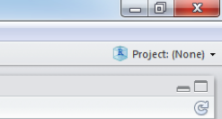
Using projects
Click on top-right option
Choose "Create Project" -> "Existing Directory" (or "New Project" if a directory does not exist)
Select a directory, e.g. "Lectures" for me
The project will be saved as a file in that directory called "Lectures.Rproj"
Opening that will open the RStudio project
Automatically sets the R working directory to that directory.
Can share project folder with collaborators (advisor) without having to adjust-modify paths.
Opens new ‘clean’ version of Rstudio each time it is used (reduces conflicts among objects). Doesn’t require collaborators to clear R’s Brain that is storing other info.
Notes:
Start following along here:

Slide 6
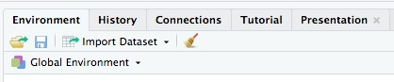
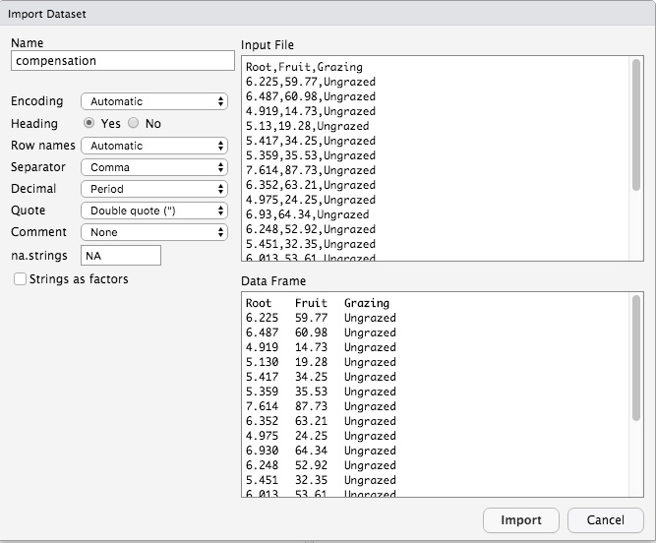
Importing the Data
Make new scriptfile called compensation.R
Copy compensation.csv to the new folder containing Lectures.rproj
Import compensation.csv data using the import dataset tool (Rstudio menu bar) and assign to object
> compensation <- read.csv("~/Downloads/Lectures/compensation.csv")
Change this import to a relative path, not absolute path. This is very important.
> compensation <- read.csv("compensation.csv")
It now looks in the project folder for the file.
>View(compensation)
Notice we now have a whole bunch of different
things named compensation; sometimes best to give
informative prefix or suffix designation
(compensation_data, compensation_script, etc.)

Slide 7
Checking the Data
Basic data checking using BaseR:
names(compensation) #variable names assigned to each column
head(compensation) #returns data for first 6 rows; also try tail() dim(compensation) #number of rows/columns; note rows come first in R str(compensation) #structure of the dataset
dplyr packge has some additional options
install.packages(“dplyr”) #fresh install if not already on your computer
library(dplyr)
glimpse(compensation) #note that all dplyr and ggplot2 code use the dataframe as first argument
tbl_df(compensation) #makes the dataframe a tibble (a tidyverse table)

Slide 8
R Works Best with ‘Tidy’ Data
Variables each have own column
Experimental units (often individuals) in rows, even if individuals are repeated (e.g. repeated measures)
Also called ‘long’ format
Incomplete data (NA) typically filtered out before analysis, but NA serves as a placeholder
Excellent Primer Here:
https://vita.had.co.nz/papers/tidy-data.pdf

Slide 9
Messy vs. ‘Tidy’ Data
Note week/rank data are stacked on top of each other.

Slide 10
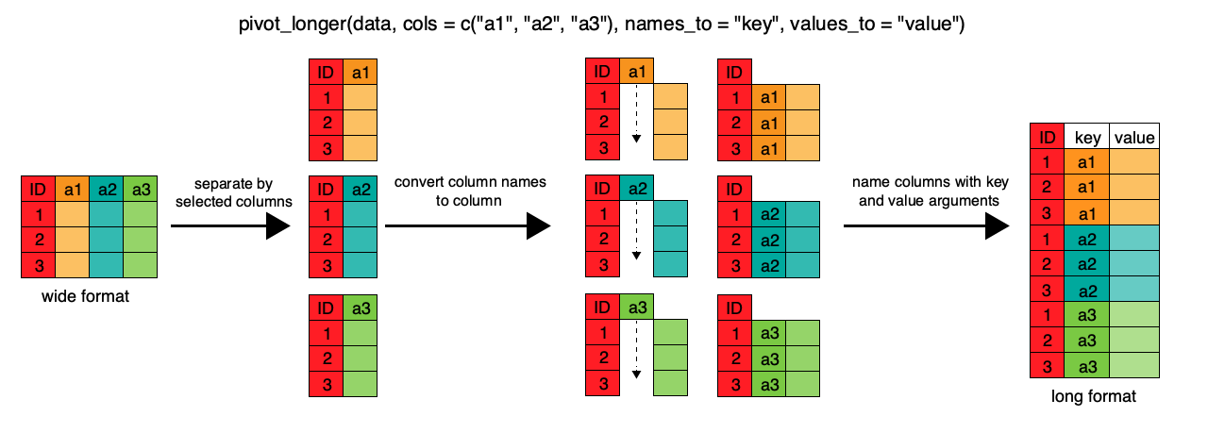
Pivot Wide Data to Get Tidy Format Long Data
pivot_longer
Can use either tidyr::pivot_longer or tidyr::gather()

Slide 11
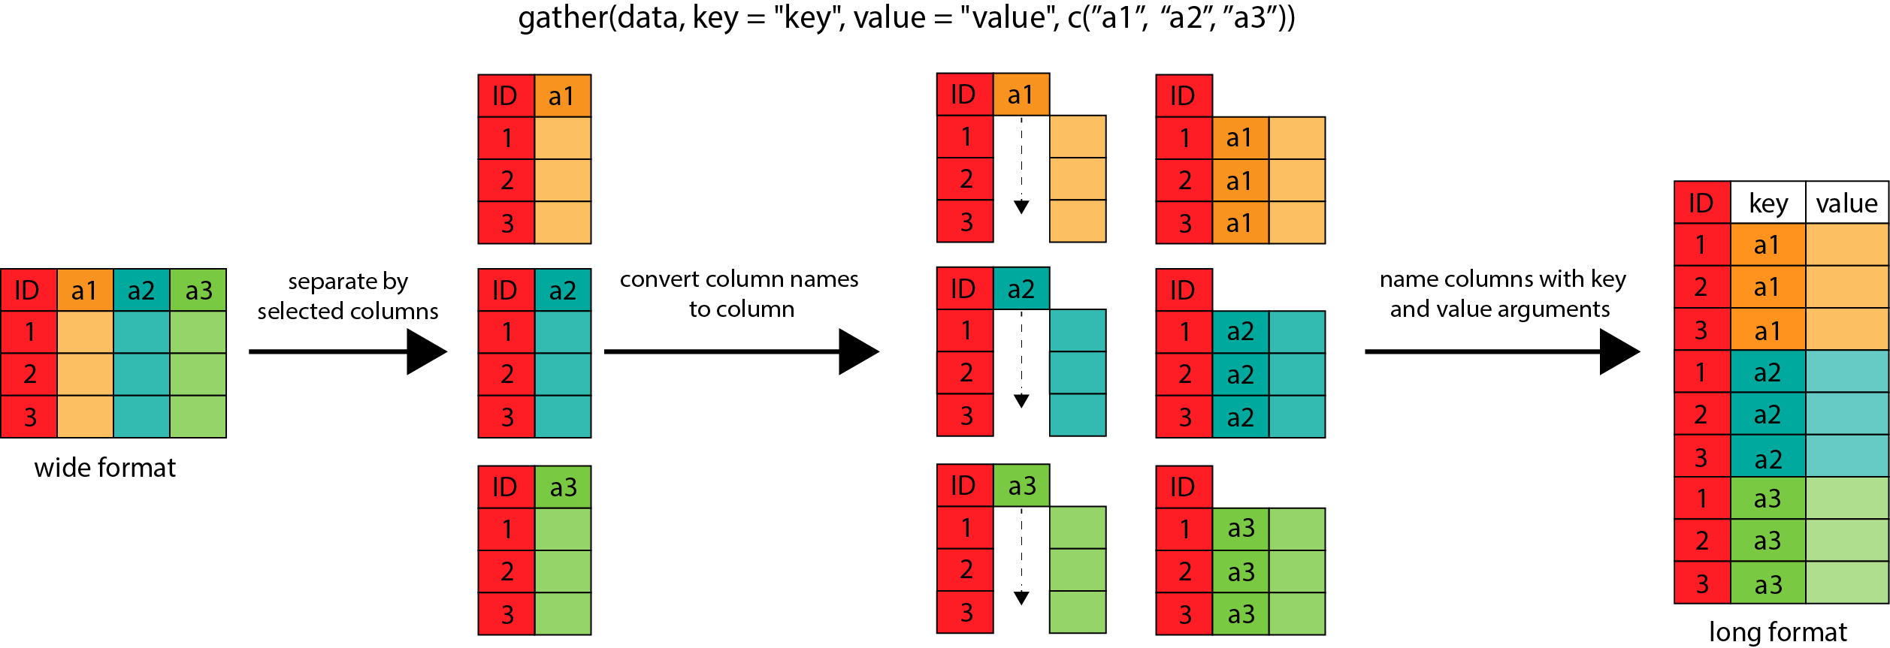
gather()

Slide 12
Import nasty.format
Copy nasty format.csv to project folder.
nasty.format <- read.csv("nasty format.csv")
str(nasty.format)
glimpse(nasty.format) #I prefer View(nasty.format)
Note that The data frame in R has 37 observations and 11 variables. The experiment involved only 36 experimental units (individuals), however. Somewhat common problem with Excel inserting extra rows/columns.

Slide 13
Filter nasty.format
So we tell R to keep only rows that have an entry in the Bottle variable, using the filter() function in the dplyr package; filter used to manipulate row data
nasty.format <- filter(nasty.format, Bottle != "")
#Keep data where Bottle value does not equal (!) an empty cell
#simply wrote over previous object with same name
and that is OK if all distillation steps listed in script file.
glimpse(nasty.format) # now 36 rows, no empty cells, but still plenty of NA cells
Notes:
dplyr operators are verbs

Slide 14
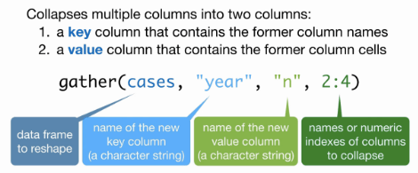
Gather nasty.format
Now we make the data tidy (stacked).
We need a new variable that contains the date on which observations were made, and a new variable containing the observations of bacterial abundance that are currently stored in columns 4 to 11.
library(tidyr) install.packages("tidyr") for install
tidy_data <- gather(nasty.format, Date, Abundance, 4:11)
View(tidy_data)
Notes:
Gather is a verb that works on columns

Slide 15
Clean the Dates
We need to remove the X at the beginning, and make R recognize that these are dates (i.e. change the variable type from Factor to a datetype variable.). First, we remove the X, using the sub_str() function in the stringr package:
install.packages("stringr")
library(stringr)
tidy_data <- mutate(tidy_data, Date = substr(Date, 2, 20))
#start with second character, take 20 (just to be safe); again notice we wrote over the existing Date column.
the mutate() function of the dplyr package, provides a neat way of changing (or adding) variables in a data frame
We will use a function in the lubridate package to force R to recognize dates.
Notes:
Gather is a verb that works on columns

Slide 16
Force Date Format
unique(tidy_data$Date) #Dollar sign refers to Date column inside tidy_data; list unique values
Dates are obviously day.month.year (typical European format)
So we use the function dmy().
install.packages("lubridate")
library(lubridate)
tidy_data <- mutate(tidy_data, Date = dmy(Date))
glimpse(tidy_data)

Slide 17
Visualize the Data: First Step of Any Analysis
install.packages("ggplot2") #unless you already have
library(ggplot2)
ggplot(data = tidy_data, aes(x=Date, y=Abundance)) +
geom_point() +
facet_wrap(~Bottle)
We tell ggplot() the data frame to look in for variables, the x- and y-variables, to plot points, and then make a graph (i.e. facet) for each of the bottles.

Slide 20
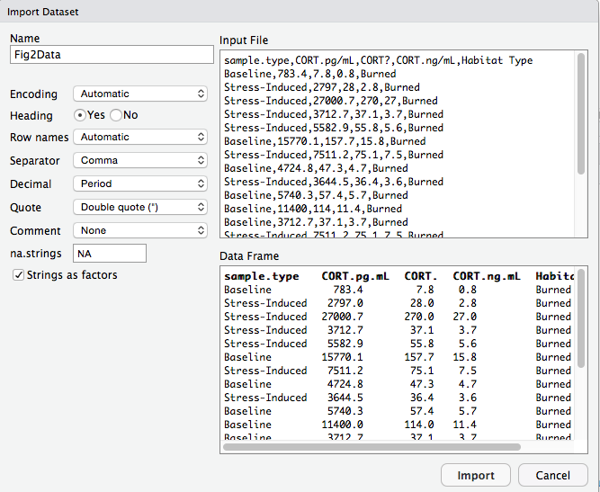
Suggested Import Methods
Method 1: The ’Import Dataset’ Tool
File -> Import Dataset -> From Text (base)
Allows quick preview before importing
Copy first two lines from Console to Script Window
Now repeatedly importing the data is automatic
> Fig2Data <- read.csv("~/Documents/Thesis/3-CORT Data/Fig2Data.csv")
> View(Fig2Data)

Slide 21
Suggested Import Methods
Method 2: The file.choose() function
Opens navigation window; returns file path for selected file
use the assignment arrow (<-) to save the imported data into an object with a name of your choice
Remember that this instruction should be put in your script file, and not typed into the Console every time.
dileptus <- read.csv(file.choose())

Slide 22
Suggested Import Methods
Method 3: Dancing With the Import Devil
(not preferred) It DOES require that you know where you are working within the hierarchy of your computer.
Session -> Set Working Directory -> Choose Directory.
This will point RStudio’s eyes directly at a folder in a specific location, the folder where the data are.
Once RStudio is looking there, the use of read.csv() becomes ‘path free’;
you need only supply the full name of the dataset, in quotation marks, for example:
compensation <- read.csv("compensation.csv").
Working directory has to be updated for each person (collaborator) using the script file
Notes:
Start Code here

Slide 23
Suggested Import Methods
Method 4: Put Your Data In the Same Place as Your Script
When R is closed and you double-click script file, Rstudio starts and defaults to folder containing script file.
It’s a bit risky to rely on this, since it only works if RStudio was not already running.
Also, you often don’t want your data in the same folder as your script (especially large complex projects)

